Slide 1






FinBit
Ellipsis Tech Series Hackathon 2020
by YODA the CODA

Slide 2
Proposed Solution
FinBit- an app that allows the user to :
track and adjust their current exposure in terms of their monetary commitments
get access to latest news that is likely to affect their portfolio
get recommendations based on their risk appetite, goals, news and latest trends
get access to relevant financial resources as well as information on the latest workshops/events relating to personal finances
set their monetary goals that would enable them to make the required actions today

Slide 3
Business Case
The target users for FinBit are mostly young adults who are entering the working world
they have less/no experience managing their savings and wish to start building their portfolio with investments
the aim is to prepare our users for the future by giving them a platform to assist them
getting investment recommendations based on real-time economic trends would educate them on the cause-effect relationship and train them to make these decisions after careful financial analysis

Slide 4
Technology/Frameworks
Backend
Sourced data from Yahoo finance API
Used React for API
Made use of Python Flask framework to create RESTful APIs
Frontend
Used Ionic React

Slide 5
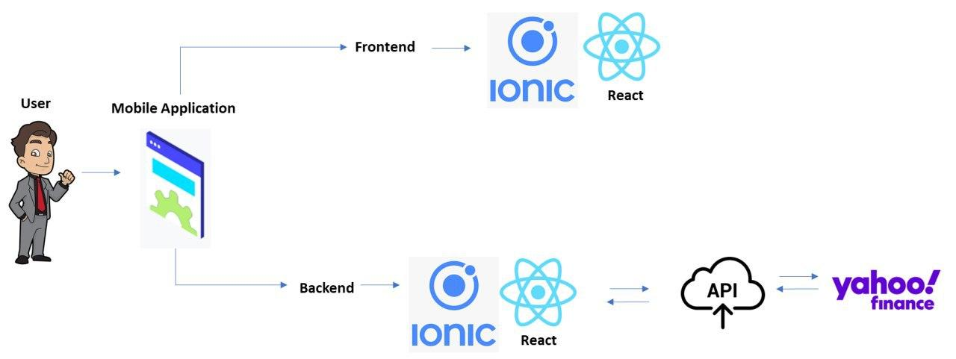
Solution architecture

Slide 6
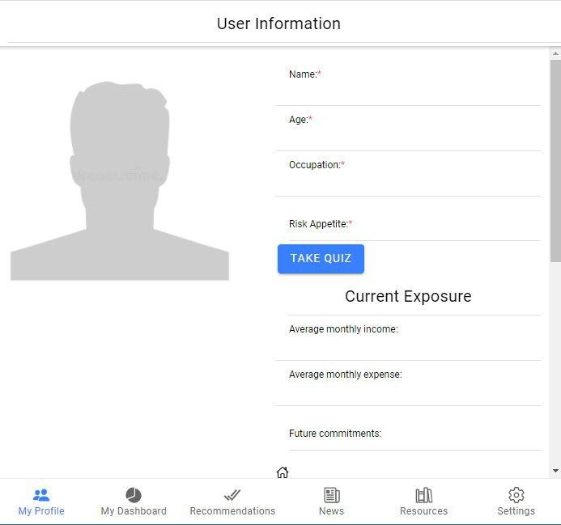
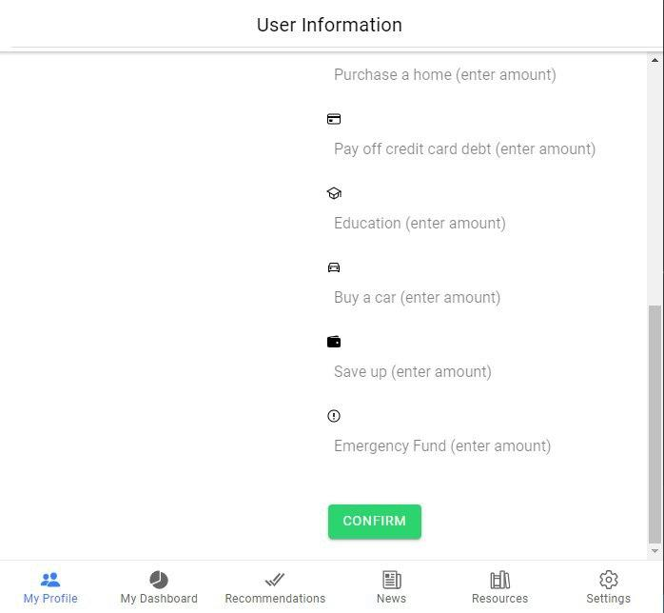
Features – User Information

Slide 7
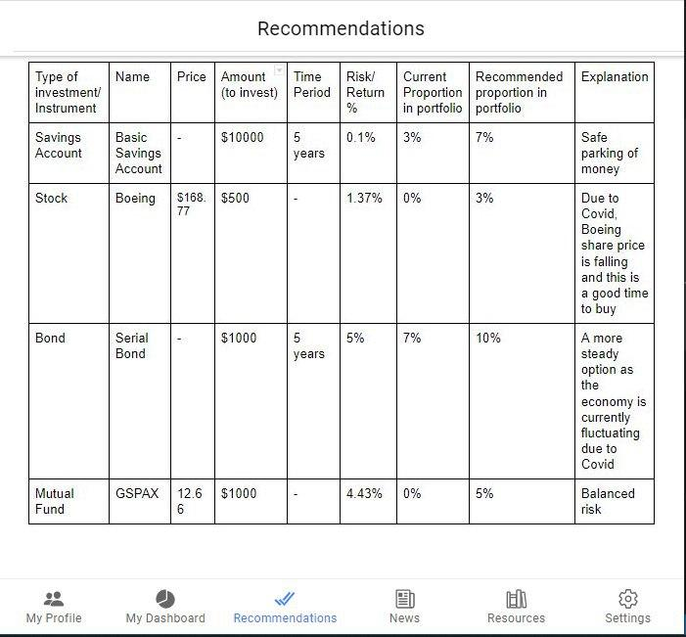
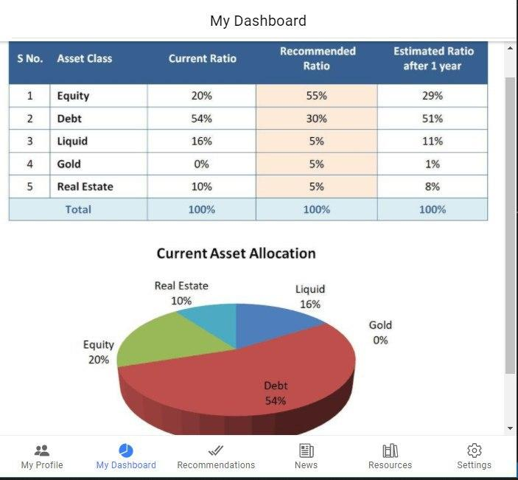
My Dashboard & Recommendations

Slide 8
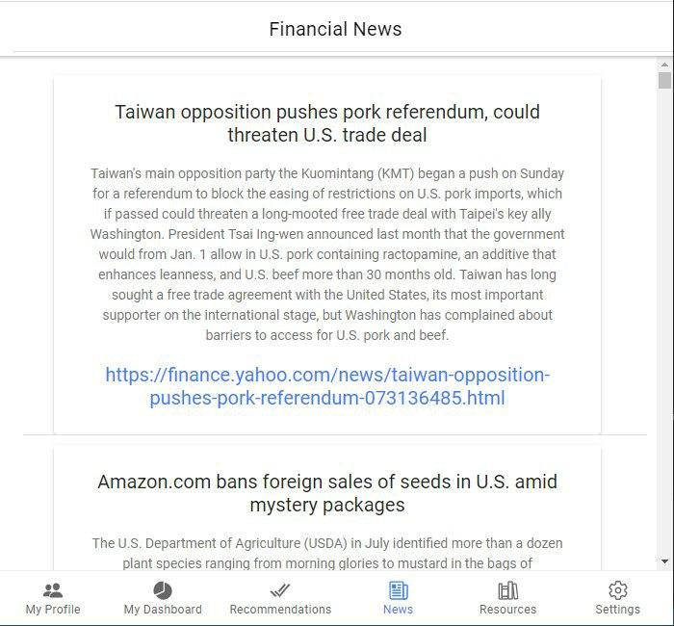
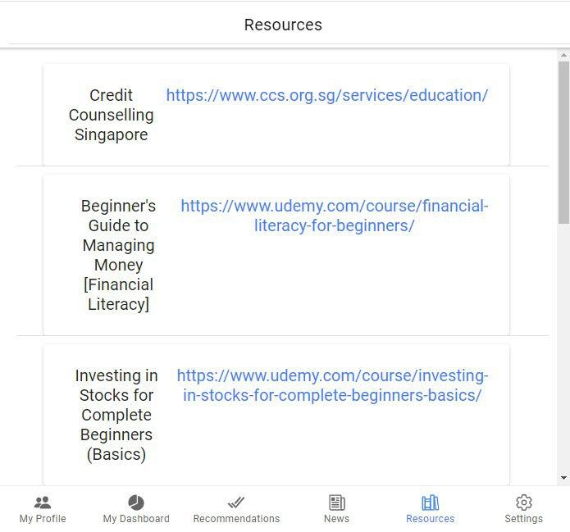
News & Resources

Slide 9

Demonstration

Slide 10





Team
Aakshi Narang
Chu Wei Hao
Dhriti Trehan
Zhang Xiaoyue

